Slide 1
Microsoft Azure AI Fundamentals: Natural Language Processing
Notes:
This content is meant to be taught as a companion to: Microsoft Azure AI Fundamentals: Natural Language Processing - Training | Microsoft Learn

Slide 2
Agenda
Natural Language Processing concepts
Natural Language Processing capabilities in Azure
Notes:
Time estimates:
- Natural Language Processing concepts: 15 minutes
- Natural Language Processing capabilities in Azure: 20 minutes
- The lab exercise should take an additional 20 minutes

Slide 3
Learning Objectives
After completing this module, you will be able to:
1
Recognize when Natural Language processing and conversational AI can be used.
2
Identify Azure AI services that include natural language processing.
3
Use text analysis for yourself.

Slide 4
Natural Language Processing (NLP) Concepts

Slide 5












What is natural language processing?
Text analysis
Opinion mining
Tokenization
{
1: a
2: boat
3: canal
4: dangled
n: …
}
Preprocessing
Training
Machine translation
Language model
Raw text
Summarization
Conversational AI
Notes:
Natural language processing (NLP) is the area of AI that deals with making sense of written and spoken language.
Typically, an NLP solution starts with a large volume of raw text, which is then pre-processed to prepare it for modeling. There are many pre-processing techniques that can be applied to text, including stop-word removal (eliminating common words with little semantic value, like “a”, “the”, etc.), stemming or lemmatization (coalescing words with the same root as a single word – so for example, “universe” and “universal” might both be represented as “univers”), and other techniques. Many of these approaches were extensively used in statistical modeling techniques that relied on counting the frequency of words in text to derive meaning, but are not so important in modern deep learning techniques. One thing that is commonly done though is to tokenize the words – representing each distinct word or phrase with a unique numeric identifier.The set of tokens for a given corpus of text represents the vocabulary for a language model.
The data is then used to train a model. Depending on the type of task you want to accomplish, the details of the model will vary. For example, you might use a fully-connected neural network to train a classification model for sentiment analysis (predicting whether a body of text is “positive” or “negative”) or you might use a more sophisticated network to train a model that encodes language tokens as vectors that encapsulate semantic relationships between words in the vocabulary. Such model are useful for translation, summarization, and text completion tasks.
Common tasks that a language model can support include:
Text analysis– Often you need to analyze a text document to extract key phrases or to identify entities it mentions, such as dates, places, people. For example, a company might use AI to analyze industry magazine articles to try to find articles that mention their products or executives or to determine the main subject of each article.
Opinion mining and Sentiment analysis – This is a common form of text analysis that calculates a score indicating how positive (or negative) a text extract is. For example, a retailer might analyze reviews from customers to determine which ones are positive and which are negative and analyze the text to uncover the key drivers of sentiment.
Machine translation – International and cross-cultural collaboration is often a key to success, and this requires the ability to eliminate language barriers. AI can be used to automate translation of written and spoken language. For example, an inbox add-in might be used to automatically translate incoming or outgoing emails, or a conference call presentation system might provide a simultaneous transcript of the speaker's words in multiple languages.
Summarization: Commonly, you might want to take a large volume of text and generate a summary of the key points.
Conversational AI– Conversational AI is a form of AI in which an AI agent engages in a dialog with a human user (commonly, this form of application is described as a “bot”) To support these kinds of interactions, a language model must be developed that enables the AI agent to interpret incoming requests, determine the semantic meaning or “intent” of the request, and formulating an appropriate response.

Slide 6



Natural language processing and conversational AI in Azure
Language | Speech | Translator
Language detection Key phrase extraction Named entity detection Sentiment analysis and opinion mining Personal information detection Summarization Question answering Conversational language understanding … | Text to speech Speech to text Speech translation Speaker identification Language identification … | Text translation Document translation Custom translation …
Notes:
We’ll cover some of the key capabilities of these NLP related services in the rest of this module.
For more details of the capabilities of these AI services, see the documentation at:
- https://learn.microsoft.com/azure/ai-services/language-service/
- https://learn.microsoft.com/azure/ai-services/speech-service/
- https://learn.microsoft.com/azure/ai-services/translator/

Slide 7
Natural Language Processing capabilities in Azure

Slide 8
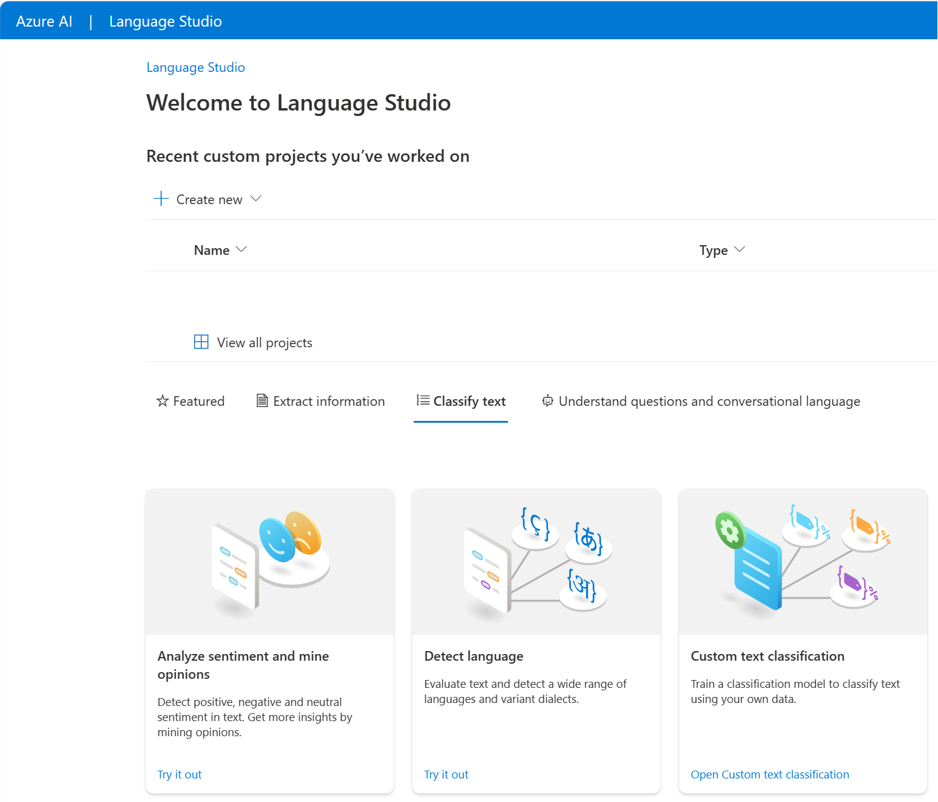
Analyzing text
I had a wonderful vacation in France.
Predominant Language: English
Sentiment: .88 (positive)
Key Phrases: “wonderful vacation”
Entities: France
Notes:
Azure AI Language service provides pretrained and customizable deep learning models to analyze text. These models use tokens and embeddings to turn words into numerical representations. Deep learning models perform calculations on these numerical representations to provide responses returned in natural language.
Text Analysis encompasses many capabilities, including:
- identifying the predominant language of the text
- identifying the sentiment of the text
- identifying key phrases
- identifying entities
The slide shows examples using the sentence “I had a wonderful vacation in France”.
Azure AI Language capabilities can be tested in Language Studio (https://language.cognitive.azure.com).

Slide 9

Demo: Explore Speech Studio
Follow along on the exercise page at: https://aka.ms/ai900-speech
In this demo, you’ll see Azure AI Speech’s capabilities in action.
Notes:
Instructors: we recommend you complete the exercise ahead of time https://microsoftlearning.github.io/mslearn-ai-fundamentals/Instructions/Labs/09-speech.html. During class, you can demonstrate the service.

Slide 10


Question answering
Define a knowledge base of question and answer pairs:
By entering questions and answers
From an existing FAQ document
By using built-in chit-chat
Consume the knowledge base from client apps, including bots.
?
!
Notes:
You can use the Language service to define a knowledge base of question and answer pairs. You can create the knowledge base by entering questions and answers, or you can import an existing Frequently Asked Questions (FAQ) list. You can also augment your questions and answers with built in chit-chat sources that include common conversational exchanges.
After creating the knowledge base, you train a model based on the question and answer data and publish it as a service. Client applications, an in particular bots, can then consume the knowledge base and use it to determine appropriate responses to user input.

Slide 11







Azure bot service
Bot
Cloud-based platform for developing and managing bots
Integration with AI Language and other services
Connectivity through multiple channels
Notes:
Azure Bot Service provides a platform for creating, deploying, and managing bots. With the Azure Bot Service, developers can use the Microsoft Bot Framework SDK to develop bots and easily deploy and manage them in Azure.
By using the Azure bot Service, you can easily integrate your bot with the Language service for language understanding or question answering; and connect your bot to multiple channels such as webchat, email, Microsoft Teams, and others.

Slide 12
Demo: Use Question Answering model with Language Studio
Follow along on the exercise page at: https://aka.ms/ai900-question-answering
In this demo, you’ll see Azure AI Language’s question answering capabilities in action.
Notes:
Instructors: we recommend you complete the exercise ahead of time https://microsoftlearning.github.io/mslearn-ai-fundamentals/Instructions/Labs/07-question-answering.html. During class, you can demonstrate the service.

Slide 13

Conversational language understanding
Switch the light on.
Entity
Intent
Utterance
Notes:
The Language service enables you to train a language model that can interpret natural language commands.
The language model consists of three primary components:
Utterances are phrases that a user might say or type – for example, "switch the light on".
Entities are specific items that are referenced in an utterance, for example a language model for a home automation application might recognize household devices such as a light or a fan.
An intent identifies the desired action for an utterance. For example, to switch something on.

Slide 14
Demo: Use Conversational Language Understanding with Language Studio
Follow along on the exercise page at: https://aka.ms/ai900-language-understanding
In this demo, you’ll see Azure AI Language’s conversational language understanding capabilities in action.
Notes:
Instructors: we recommend you complete the exercise ahead of time https://microsoftlearning.github.io/mslearn-ai-fundamentals/Instructions/Labs/08-conversational-language-understanding.html. During class, you can demonstrate the service. You can show students the Language Studio containing the conversational language understanding project, and then demonstrate how to call the published service to predict an intent.

Slide 15

Speech recognition and synthesis
Use the speech-to-text capabilities of the Speech service to transcribe audible speech to text
Use the text-to-speech capabilities of the Speech service to generate audible speech from text
Notes:
The Speech service provides a Speech-to-Text API that you can use to implement text recognition functionality. The service supports text transcription in more than 60 languages. {A speech bubble with an arrow pointing to the text "Use the speech-to-text capabilities of the Speech service to transcribe audible speech to text" is displayed}
Conversely, the Text-to-Speech API can synthesize audible speech from text, with the option to specify regionally appropriate voices for human-like pronunciation {The text "Use the text-to-speech capabilities of the Speech service to generate audible speech from text" is displayed with an arrow pointing to a speech bubble}

Slide 16
Exercise: Analyze text with Language Studio
Use the hosted environment and Azure credentials provided for this exercise.
In this exercise, you will use the Azure AI Language service to analyze text.
The instructions are also available on Learn: https://aka.ms/ai900-text-analysis
Notes:
Point out that exercises are also available on Microsoft Learn for all of the other tasks demonstrated and discussed in this PowerPoint. https://microsoftlearning.github.io/mslearn-ai-fundamentals.

Slide 17
Knowledge check
1
What are some capabilities included in the Azure AI Language service?
Translation and bot deployment
Speech recognition
Text analysis, custom question answering, conversational language understanding
2
You want to use the Azure AI Language service to determine the key talking points in a text document. Which feature of the service should you use?
Sentiment analysis
Key phrase extraction
Entity detection
3
You want to create a knowledge base for bots. What service would you use?
Conversational Language Understanding with the Azure AI Language service
Question Answering with the Azure AI Language service
Azure AI Document Intelligence
Notes:
Allow students a few minutes to think about the questions, and then reveal the correct answers.

Slide 18

Summary
Natural Language Processing concepts
What is Natural Language Processing?
What is Conversational AI?
Natural Language Processing and conversational AI in Azure
Natural Language Processing capabilities in Azure
Analyzing text
Speech recognition and synthesis
Conversational language understanding
Question answering
Azure Bot service

Slide 19

References
Read more about:
Fundamentals of Text Analysis with the Language Service
Fundamentals of Question Answering with the Language Service
Fundamentals of Conversational Language Understanding
Fundamentals of Azure AI Speech
Through the content on Learn: Microsoft Azure AI Fundamentals: Natural Language Processing - Training | Microsoft Learn
Notes:
Encourage students to review the content on Learn for more information.

Slide 20
Closing slide

